Slide 1
WAVES AND SOUND
AP Physics

Slide 2
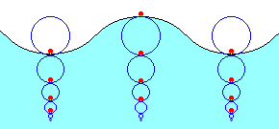
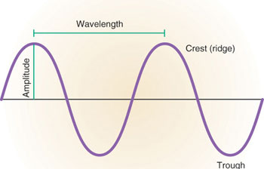
WAVES
A _________________ is a disturbance which propagates through a medium with little or no net displacement of the particles of the medium

Slide 3
PARTS OF A WAVE
crest
λ: wavelength
3
equilibrium
A: amplitude
2
4
6
x(m)
-3
y(m)
trough

Slide 4
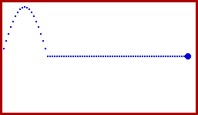
WAVE SPEED
The __________ of a wave is the distance traveled by a given point on a wave (like a crest) in a given interval of time
v = ______
v: wave speed/velocity (m/s)
d: distance (m)
t: time (s)
v = ______
λ: wavelength (m)
f: frequency (Hz = 1/s)

Slide 5
SOUND SPEED
1.__________ travels at approximately 340 m/s, and light travels at 3 x 10⁸ m/s. How far away is a lightning strike if the sound of the thunder arrives at a location 2.0 seconds after the lightning is seen?

Slide 6
Problem: Sound travels at approximately 340 m/s, and light travels at 3.0 x 10⁸ m/s. How far away is a lightning strike if the sound of the thunder arrives at a location 2.0 seconds after the lightning is seen?

Slide 7
FREQUENCY & PERIOD
The period, T, of a wave is the _______ of the frequency:
T = _______

Slide 8
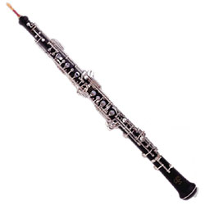
2.
The frequency of an oboe’s A is 440 Hz. What is the period of this note? What is the wavelength? Assume the speed of sound in air to be 340 m/s.

Slide 9
Problem: The frequency of an oboe’s A is 440 Hz. What is the period of this note? What is the wavelength? Assume a speed of sound in air of 340 m/s.

Slide 10
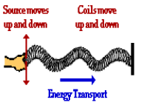
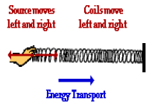
TYPES OF WAVES
Transverse
Compressional/ Longitudinal
A __________ is a wave in which particles of the medium move in a direction _______________ to the direction the wave moves
A __________ or __________________is a wave in which particles in the medium move in a direction __________ to the direction the wave moves

Slide 11
EXAMPLES OF WAVES
Waves on a string (transverse)
Water waves (transverse)
Earthquakes (transverse and compressional)
Sound waves (compressional)
Produced through vibration
Has a pitch (from frequency)
Has volume (from amplitude)
Light (transverse)
Has color (from frequency)
Has brightness (from amplitude)
Light travels like a wave, and like a particle called a photon

Slide 12
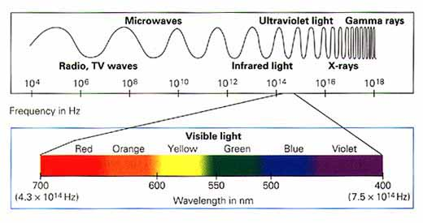
LIGHT
Visible light is a type of electromagnetic _____
It also acts like a particle called a _____

Slide 13
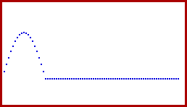
WAVE BEHAVIOR 1: REFLECTION
___________ occurs when a wave strikes a medium boundary and “bounces back” into the original medium
Completely reflected waves have the _______ energy and speed as the original wave
______________reflection: wave reflects with inverted phase - occurs when reflecting medium has greater density.
______________reflection: wave reflects with same phase - occurs when reflecting medium has lesser density

Slide 14
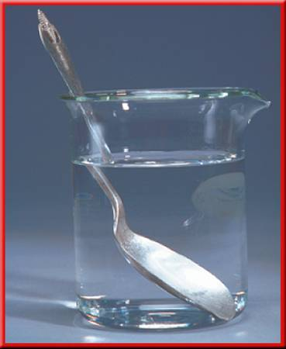
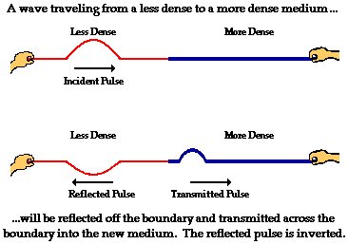
WAVE BEHAVIOR 2: REFRACTION
_____________ occurs when a wave is transmitted from one medium to another
Refracted waves may _________ speed and wavelength
Refraction is almost always accompanied by some reflection
Refracted waves do ________ change frequency

Slide 15
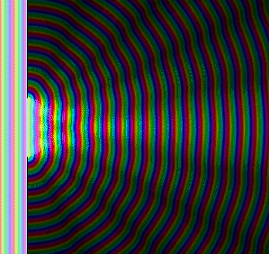
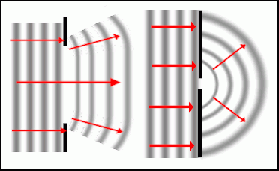
WAVE BEHAVIOR 3: DIFFRACTION
_________ is the bending of a wave AROUND a barrier
Diffracted waves can interfere and cause “diffraction patterns”

Slide 16
SOUND
Sound travels through the air at approximately _________
It travels through other _________, usually faster
Sound waves are started by vibration
We hear sound as “high” or “low” depending on the wave’s ___________. Sounds with short wavelengths have high frequencies and sound high-pitched.
The __________of a sound’s vibration is interpreted as loudness. We measure loudness on the decibel scale (which is logarithmic)

Slide 17
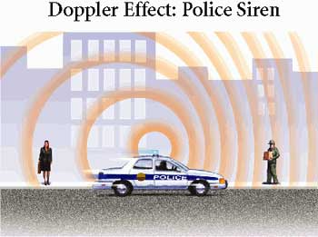
AWESOME WAVE PHENOMENON: THE DOPPLER EFFECT
The _____________ is the raising or lowering of the perceived frequency of a wave based on the relative motion of the source of sound and the observer
For a sound wave, the pitch (based on frequency) increases as the source moves toward you and decreases as it moves away

Slide 18
A FINAL WORD ABOUT “PITCH”
_________ rises when frequency rises and the sound is “higher”.
_________ is lowered when the frequency is lowered and the sound is “lower”.

Slide 19
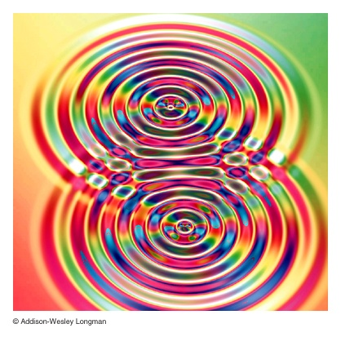
PRINCIPLE OF SUPERPOSITION
When two or more waves pass a particular point in a medium _______________, the resulting displacement at that point in the medium is the sum of the displacements due to each individual wave
The waves _________with each other

Slide 20
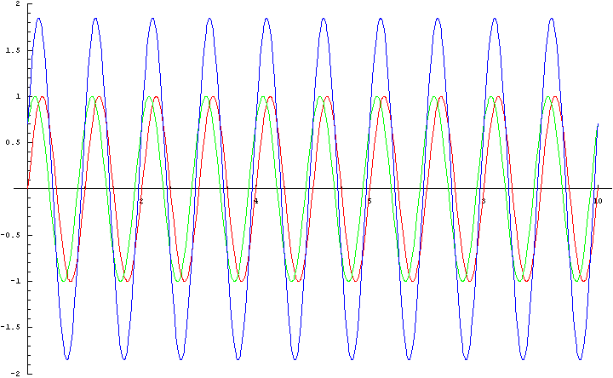
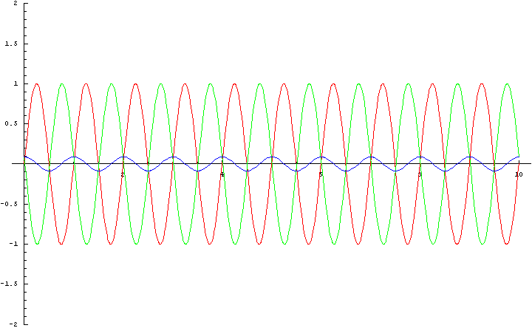
TWO TYPES OF INTERFERENCE
____________Interference
____________ Interference
If waves are “in phase”
Crests and troughs are aligned
Displacement is in the same direction – add!
If waves are “out of phase”
Crests and troughs not aligned
Displacement in opposite directions – subtract!

Slide 21
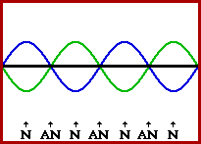
STANDING WAVES
A standing wave is _________ back and forth between fixed ends (string, spring, pipe, etc.)
Reflection may be fixed or open-ended
____________ of the wave upon itself results in a pattern of constructive and destructive interference and an enhanced wave

Slide 22
FIXED END STANDING WAVES

Slide 23
OPEN-END STANDING WAVES

Slide 24
MIXED STANDING WAVES

Slide 25
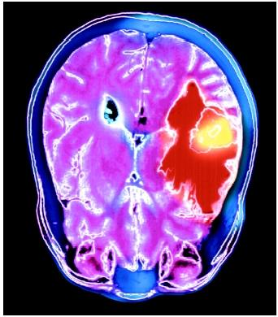
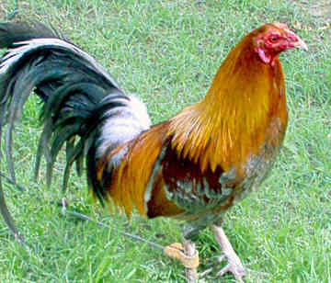
RESONANCE
Resonance occurs when a _________________________ occurs at a natural frequency for another oscillator
The first oscillator will cause the second to vibrate

Slide 26
PERIODIC MOTION
Motion that ______________ over a fixed and reproducible period of time is called periodic motion
Mechanical devices can be designed to have periodic motion – these devices are called _______________
__________________________undergo simple harmonic motion (position vs. time is “sinusoidal”) and are referred to as simple harmonic oscillators

Slide 27
SIMPLE HARMONIC MOTION

Slide 28
SIMPLE HARMONIC MOTION

Slide 29
OSCILLATOR DEFINITIONS
Amplitude:
__________________________from equilibrium
Related to energy
Units - meters
Period:
________________required for one full oscillation
Units – seconds
Period of a spring :
Frequency:
______________the oscillator is oscillating
Units – Hz or 1/s

Slide 30
PRACTICE
A 300-g mass attached to a spring undergoes simple harmonic motion with a frequency of 25 Hz. What is the force constant of the spring?

Slide 31
MORE PRACTICE
An 80-g mass attached to a spring hung vertically causes it to stretch 30 cm from its unstretched position. If the mass is set into oscillation on the end of the spring, what will be the period?

Slide 32
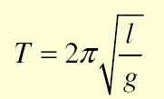
PENDULUMS
Pendulums can also be thought of as ________ ___________________
Displacement needs to be ______ for it to work properly
Period of a pendulum:

Slide 33
PRACTICE
Suppose you notice that a 5-kg weight tied to a string swings back and forth 5 times in 20 seconds. How long is the string?
The period of a pendulum is observed to be T. Suppose you want to make the period 2T. What do you do to the pendulum?

Slide 34
Electromagnetic Waves
All Electromagnetic Waves travel at the “speed of light”
3 x 10⁸ m/s
Or
300,000 Km/s

Slide 35
The Electromagnetic Spectrum
________________________ are categorized by how they interact with matter. This depends on their frequency.
The entire range of EM frequencies is the Electromagnetic Spectrum.

Slide 36
Radio Waves
________________: the longest wavelengths (longer than 1mm) and lowest frequency
They are used in communications, radar, microwaves, MRIs, and TVs

Slide 37
Microwaves
_____________ are radio waves with wavelengths less than 30 cm but longer than 1mm
Cell phones and satellites use microwaves

Slide 38
Infrared Waves
________________ have wavelengths between 1mm and 750 billionths of a meter
Thermal energy travels in infrared waves
Remote controls and
CD-ROM drives also use
infrared waves

Slide 39
Visible Light
______________ has wavelengths ranging from 750 billionths to 400 billionths of a meter
The spectrum of visible light ranges from red (longest λ) to violet (shortest λ)

Slide 40
Visible Light
(ROYGBIV)

Slide 41
Ultraviolet Waves
______________, or UV waves, have wavelengths of 400 billionths to 10 billionths of a meter
UV waves can cause skin damage such as sunburn, wrinkling, and cancer

Slide 42
Ultraviolet Light
UV light enables your body to make vitamin D
UV waves can kill bacteria by damaging its DNA

Slide 43
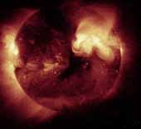
X-Rays
___________have wavelengths between ten billionths of a meter and ten trillionths of a meter
X rays are commonly used by doctors
and dentists

Slide 44
Gamma Rays
_____________have wavelengths shorter than 10 trillionths of a meter
Gamma rays are produced by radioactive decay or other subatomic processes

