Slide 1

Forces and Newton’s Laws NOTES
Force - a push or pull
A Force
  1. gives energy to objects
  2. causes a change in motion, such as:
Starting
Speeding Up
Changing Direction
Stopping
Slowing Down
(Note: all of these are forms of acceleration)

Slide 2
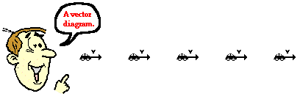
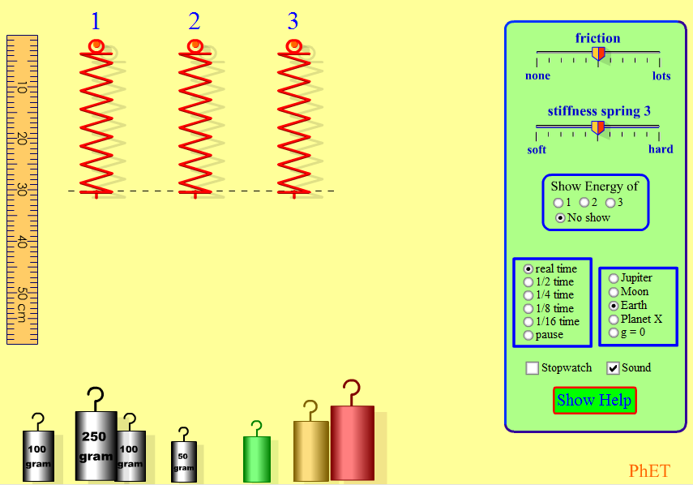
  3. May change an object's shape
  4. Forces can be represented with arrows called vectors.
  Vectors show the direction and magnitude (size) of a force.
  5. Forces are measured in Newtons (N). N = m/s²
Tool used is a spring scale
Click me!

Slide 3
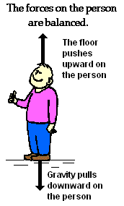
All of the forces acting on an object together are known as net forces.
Balanced forces are equal forces
    No movement or change in movement occurs
    Net force is zero
    EX:
M
Unbalanced forces are unequal forces
    Some change in movement occurs
    Net force is greater than zero
    EX:
M

Slide 4
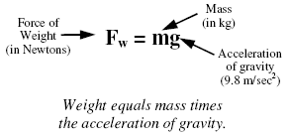
Sources of Force
Gravity is a force that pulls objects down—dependent on size of object and distance.
(Gravity is acceleration.)
Weight is the force of gravity on mass. Weight changes if gravity changes; mass does not change with gravity.

Slide 5
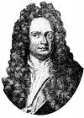
Newton's Laws of Motion
Forces can be described with Newton’s 3 Laws of Motion.
First Law - Law of Inertia
An object at rest will remain at rest and an object in motion will remain in motion unless acted upon by an unbalanced force.
A moving object moves in a straight line with constant speed unless a force acts on it.
An object's tendency to resist a change in motion is inertia.
  If it is at rest, it stays at rest.
  If it is moving, it keeps moving in the same direction.

Slide 6
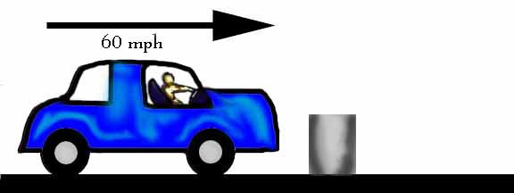
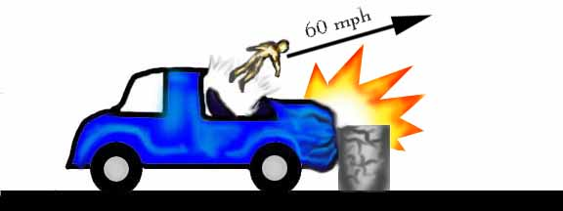
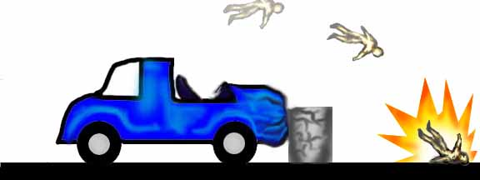
  Objects do not change their motion unless a force acts on them
    An object will NOT start moving unless a force acts on it.
    An object will NOT stop moving unless a force acts on it.
    An object will NOT change speed unless a force acts on it.
    An object will NOT change direction unless a force acts on it.
  The more mass an object has, the more inertia it has. This means that the more mass an object has, the harder it is to move, stop, or change the speed or direction of the object.

Slide 7
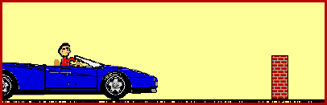
Don’t let this be you. Wear seat belts!
Because of inertia, objects (including you) resist changes in their motion. When the car going 80 km/hour is stopped by the brick wall, your body keeps moving at 80 m/hour.

Slide 8
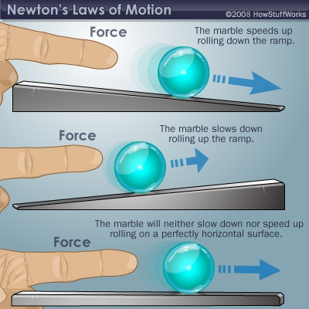

Slide 9
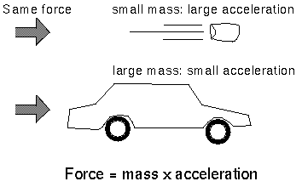
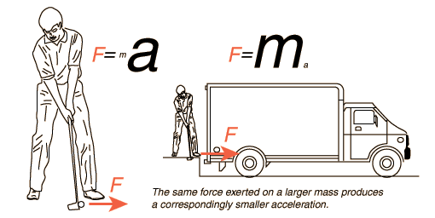
Second Law - Law of Acceleration
  Forces causes acceleration while mass resists acceleration.
  If an object is acted upon by a net force, the change in velocity will be in the direction of the force. (Objects move in the direction they are pushed or pulled.)
  Mass, force, and acceleration are related. The acceleration of an object is proportional to the force acting on it and inversely proportional to its mass.

Slide 10
  Acceleration can be calculated as:
Acceleration = force/mass a = F/m
or
Force = mass X acceleration
Example: You are pushing a friend on a sled. You push with a force of 40 N. Your friend and the sled together have a mass of 80 kg. Ignoring friction, what is the acceleration of your friend on the sled?

Slide 11
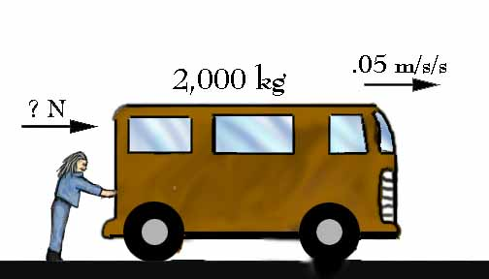
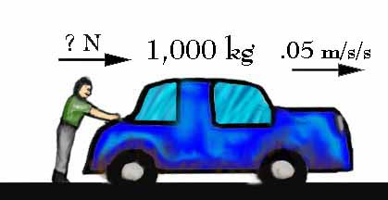
    The more mass an object has, the more force is needed to accelerate the object.
    Small masses are easy to accelerate. Big masses are hard to accelerate.
    The more force that is applied to an object the more it will accelerate.

Slide 12
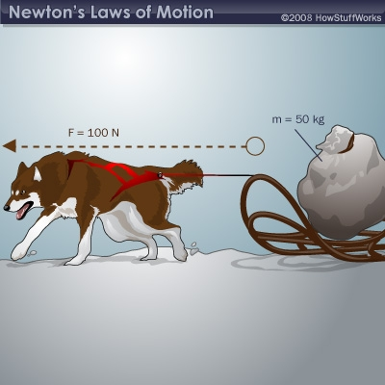
What is the acceleration of the dog sled?
Unbalanced or balanced?

Slide 13
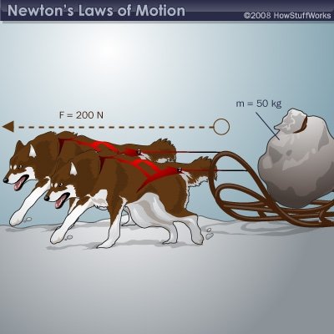
Unbalanced or balanced?
Notice that doubling the force by adding another dog doubles the acceleration. Oppositely, doubling the mass to 100 kg would halve the acceleration to 2 m/s².

Slide 14
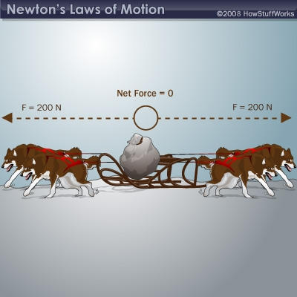
Unbalanced or balanced?
If two dogs are on each side, then the total force pulling to the left (200 N) balances the total force pulling to the right (200 N). That means the net force on the sled is zero, so the sled doesn’t move.

Slide 15

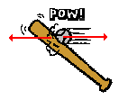
For example:
Hitting a baseball—the harder
the hit, the faster the ball goes.
The positioning of football players—massive players on the line with lighter (faster to accelerate) players in the backfield
Flicking a ping pong ball vs. a bowling ball (OUCH!)

Slide 16
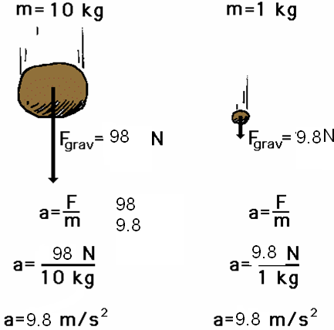
Newton’s 2nd Law proves that different masses accelerate to the earth at the same rate, but with different forces.
We know that objects with different masses accelerate to the ground at the same rate.
However, because of the 2nd Law we know that they don’t hit the ground with the same force.
F = ma
98 N = 10 kg x 9.8 m/s/s
F = ma
9.8 N = 1 kg x 9.8 m/s/s

Slide 17
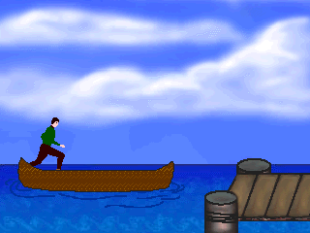
Third Law - Law of Equal and Opposite Forces
  States that for every action there is an equal and opposite reaction.
  Forces always come in pairs. One force is called the action and the other is called the opposite reaction.

Slide 18

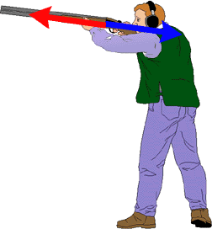


Examples:
    As a man exits a canoe, the canoe moves in the opposite direction. The canoe has an equal and opposite reaction to the man’s action.
    A gun exerts a force on a bullet and the bullet exerts the
    SAME force on the gun.
    As the paddle is pushed backward in the water the canoe moves forward.
    A swimmer pushes water back with his arms, but his body
    moves forward.

Slide 19
Check Your Understanding
What acceleration will result when a 12 N net force applied to a 3 kg object? A 6 kg object?
A net force of 16 N causes a mass to accelerate at a rate of 5 m/s². Determine the mass.
How much force is needed to accelerate a 66 kg skier 1 m/s²?
What is the force on a 1000 kg elevator that is falling freely at 9.8 m/s²?

Slide 20
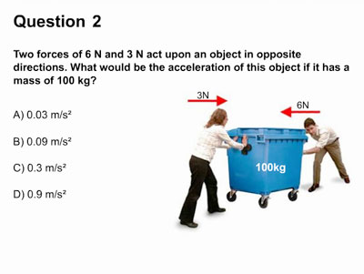

Slide 21
Newton’s 3 Laws
Inertia
F = m x a
Action, Reaction

