Slide 1
Science Starter
What is a chemical that is composed of one element?
What is a chemical that is composed of more than one element?

Slide 2
Properties of Matter
Chemistry

Slide 3
Physical Properties and Changes
A physical property is a characteristic that can be observed or measured without changing the identity of the substance.
Color, shape, mass, etc.
A change in a substance that does not involve a change in the identity(what makes it up) of the substance is called a physical change.
grinding, cutting, melting, and boiling, dissolving

Slide 4
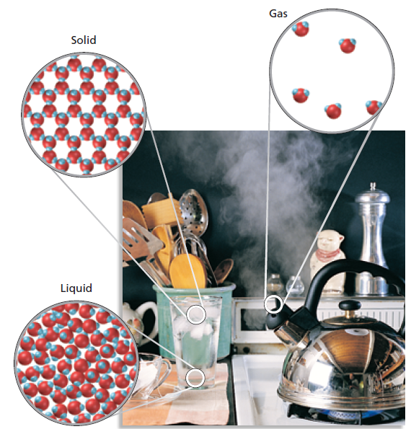
Physical Changes
A change of state is a physical change of a substance from one state to another. The chemical composition of the substance does NOT change.
Just the movement of the particles.
The three physical
states are solids, liquids,
and gases.

Slide 5
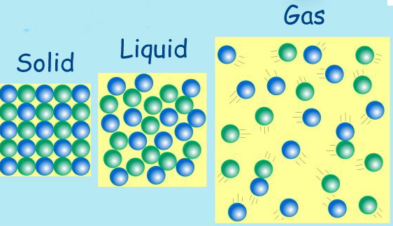
Properties of Solids, Liquids, and Gases
Definite shape and volume
Indefinite shape but definite volume
Indefinite shape and volume

Slide 6
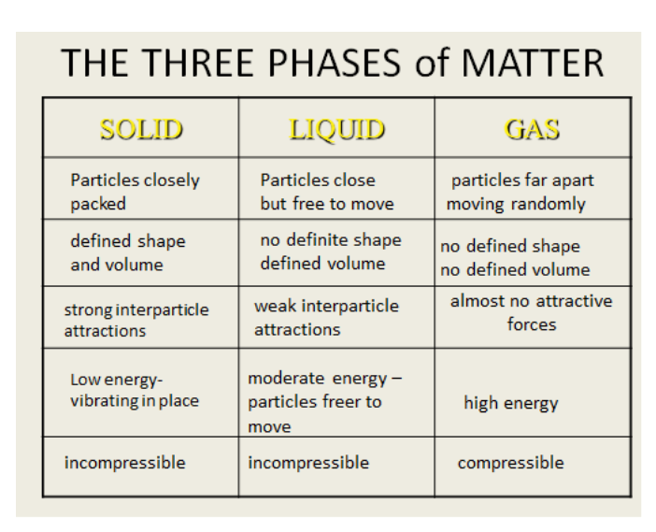

Slide 7
Chemistry of Chemicals
A chemical property relates to a substance’s ability to undergo changes that transform it into different substances.
These are easiest to see when they react to form new substances.
Words that tell you a chemical property:
Reactivity, flammability, combustibility, etc.
A change in which one or more substances are converted into different substances is called a chemical change or chemical reaction.

Slide 8
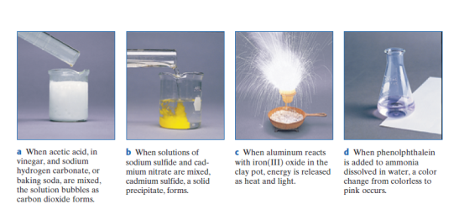
Signs Of A Chemical Change
1. Release of a gas 3. Formation of a precipitate
2. Heat/Light 4. Color Change

Slide 9
Chemical Reactions
The substances that react in a chemical change are called the reactants. The substances that are formed by the chemical change are called the products.
“Reactants react to produce products.”
Chemical changes are when NEW substances are made. Elements are completely rearranged.

Slide 10
Common Chemical Reactions/Changes
Baking Cookies
Burning gasoline in a car
Food digestion
_______________________
_______________________
_______________________

Slide 11
Mixtures
A mixture is matter that can be physically separated into its component parts. Each of the parts retains (keep) their chemical identities.
Common Mixtures
_______Lucky Charms Cereal____________
____________________________________
____________________________________
____________________________________

Slide 12
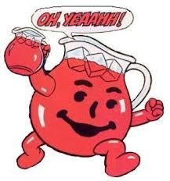
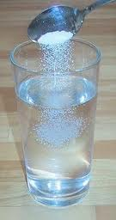
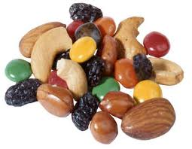
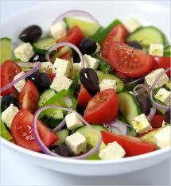
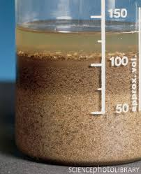
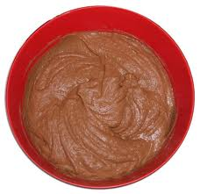
Hetero vs Homogeneous Mixtures
Using the pictures, come up with your own definitions.

Slide 13
Different Types of Mixtures
The two different types of mixtures are heterogeneous and homogeneous.
Mixtures that are uniform throughout are said to be homogeneous.
You can’t see the different parts.
Mixtures that are not uniform throughout are said to be heterogeneous.
You can see the different parts.

Slide 14
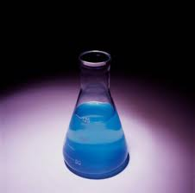
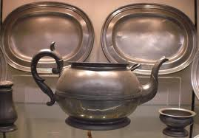
Solution
Solutions are homogenous mixtures.
Sugar in water
Salt in water
Dyes in water
Metals in Metals
(these are called alloys)

Slide 15
Matter Break Down
Mixtures can be separated into it’s original components. These are either elements or compounds.
Elements CAN’T be broken down.
Compounds can be broken down into simpler substances using CHEMICAL MEANS ONLY…

Slide 16
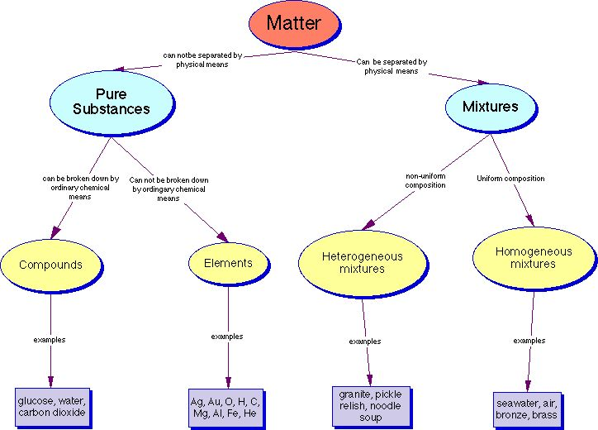
Matter Flow Chart

Slide 17
Separation of Mixtures
I. Hand Separation-Literally separating by appearances.
II. Filtration-Separation by size using a filter. The filter allows for smaller particles to leave while containing the larger ones.
III. Distillation-Separation by boiling points. Substances that are easier to boil (lower BP) evaporate faster.
IV Centrifugation-separation by the different phases.
V Chromatography-separating by similar characteristics of the compounds

Slide 18
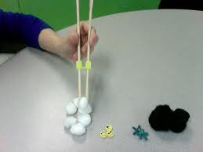
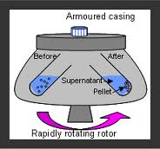
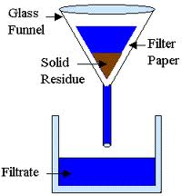
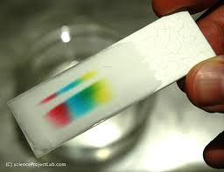
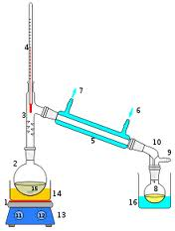
I. Hand Separation
II. Filtration
III. Distillation
IV. Centrifugation
V. Chromatography

Slide 19
Group Practice
A pure white, solid material that looks like table salt releases gas when heated under certain conditions. There is no change in the appearance of the solid, but the reactivity of the material changes.
Did a chemical or physical change occur?
How do you know?

Slide 20
Group Practice
In trying to identify a sample of a pure substance, we observe the following properties. Tell whether each one is a chemical property or a physical property.
Its mass is 124.3 g.
It is a shiny solid at room temperature.
It is easily etched by nitric acid.
It melts when heated to 670°C.
It is a good heat conductor.
It is a good conductor of electrical energy.

Slide 21
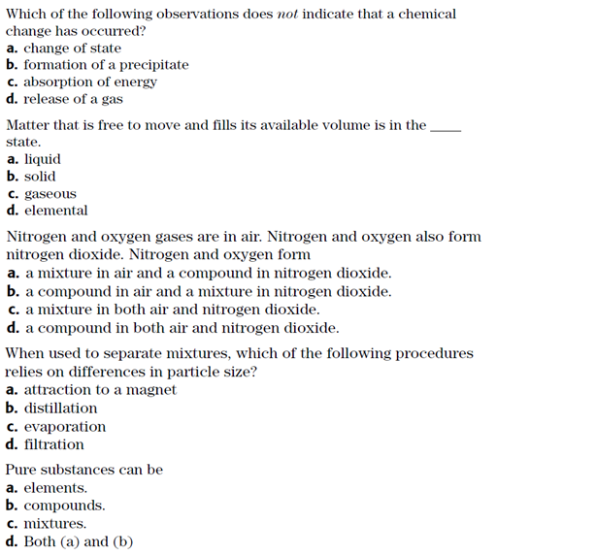
Stamp It

