Slide 1
Stratus
Cirrus
Altostratus
Cumulus
Cumulonimbus
Cirrocumulus
Stratocumulus
Nimbostratus Altocumulus

Slide 2
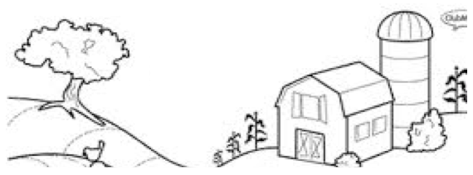
~8,000 meters
~2,000 meters

Slide 3
~8,000 meters
~5,000 meters
~5,000 meters

Slide 4
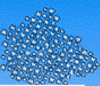
~8,000 meters
~2,000 meters
~2,000 meters
~2,000 meters

Slide 5
~2,000 meters

