Slide 1
Chemical And Physical Change

Slide 2
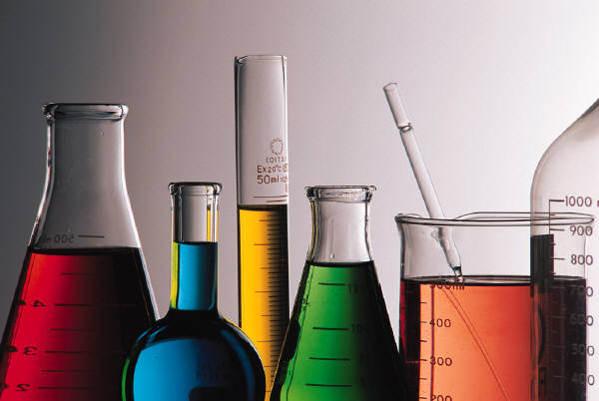
Chemical Change
A change which results in the formation of a new substance.

Slide 3
Chemical Property
Characteristics of matter thatn can only be observed when one substance changes into a different substance, such as iron to rust.

Slide 4
Evidence of Chemical Change
A new substance is formed.
A precipitate is formed.
A gas is produced.
Observable changes in properties—ex. Bread dough rising.
Color change—be careful with this one.
Flammability—the ability to burn.
Ability to rust—reaction with oxygen to produce rust.

Slide 5
Physical Change
A change which does NOT result in the formation of a new substance.

Slide 6
Physical Property
Characteristics of matter than can be seen through direct observation such as density, melting point, and boiling point, brittleness, ductility, transparency, and elasticity.

Slide 7
Physical Properties cont.
Melting point: temperature at which a substance goes from solid to liquid.
Density: mass per unit of volume
Boiling point: temperature at which a substance goes from a liquid to a gas.
Brittleness: tendency to crack or break
Ductility: ability to bend without breaking
Elasticity: ability to be stretched or compressed then return to its original size
Transparency: the property of letting light pass through something.

Slide 8
Examples of Physical Change
cutting
mixing
tearing
folding
bending
flattening

Slide 9
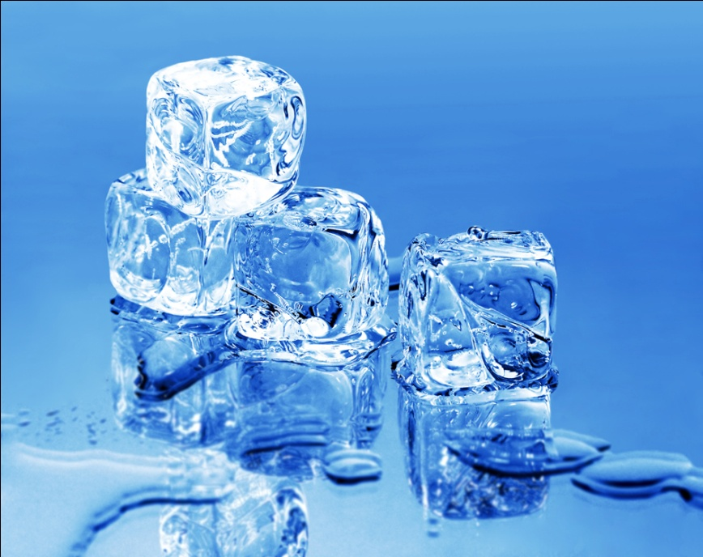
All changes in state are physical!!!
Freezing
Boiling
Evaporating
Condensing
Melting

