Slide 1
Do Now
What is the atmosphere?
What does the atmosphere protect us from?
In which layer of the atmosphere does most weather occur?

Slide 2
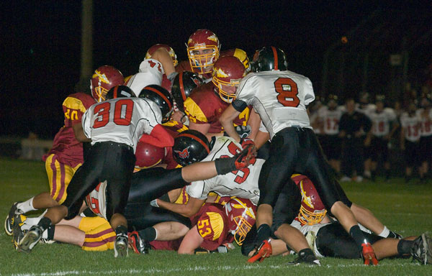
Who in the pile has the most pressure
pushing on them? Why?

Slide 3
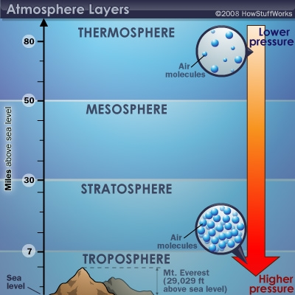
Air Pressure Works in the Same Way
Air pressure is highest at the bottom of the atmosphere (where we are).
Air pressure decreases the higher you go.

Slide 4
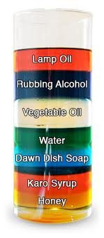
A lot like our Density Columns
Where the most dense (most particles per unit volume) liquids go to the bottom).

Slide 5
Group Work
Use your notes from yesterday, and the science textbook, to fill in the table.
We will do the first one together.
Name of Layer 1: | Distance from Earth’s Surface: | Rank of Air Pressure [1-5] (1 = highest pressure, 5 = lowest pressure).
Facts about Layer 1:

Slide 6
Group Work
Use your notes from yesterday, and the science textbook, to fill in the table.
We will do the first one together.
Name of Layer 1: | Distance from Earth’s Surface: | Rank of Air Pressure [1-5] (1 = highest pressure, 5 = lowest pressure).
Facts about Layer 1:

Slide 7
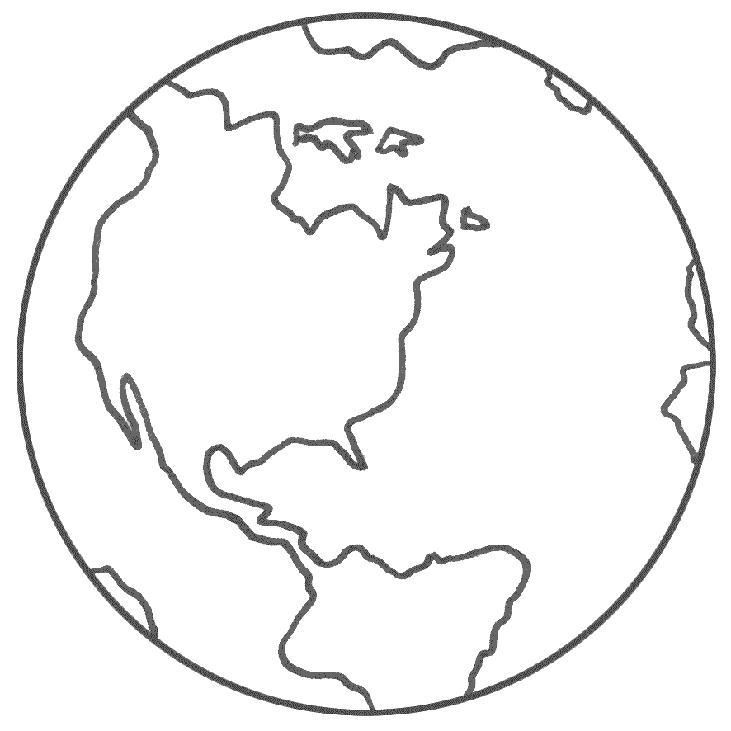
Atmosphere Foldable
You will cut out colored, half-circles (maybe half-ovals) and staple them on the bottom edge. Each circle represents a layer of the atmosphere. You will label each layer so it can be seen from the outside of your foldable. Then you will fold each layer open and write what happens in that layer below. Then you can use this foldable to help you study later!
Exosphere
Thermosphere
Mesosphere
Stratosphere
Troposhere
*Not drawn to scale

Slide 8
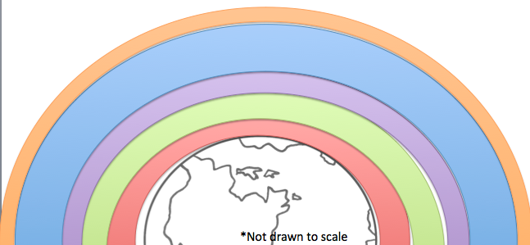
5. _____________________
4. _____________________
3. _____________________
2. _____________________
1. _____________________

Slide 9
Teacher prints this for the start of the student foldables. For the other layers, I hand drew circles/ovals for each size and then made photo copies on colored paper for students.
*Not drawn to scale
*Not drawn to scale
*Not drawn to scale
*Not drawn to scale
*Not drawn to scale
*Not drawn to scale

