Slide 1
Do Now
1. What is the atmosphere and what does it do?
2. What gases are in the atmosphere?

Slide 2
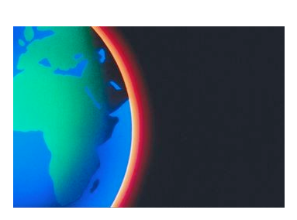
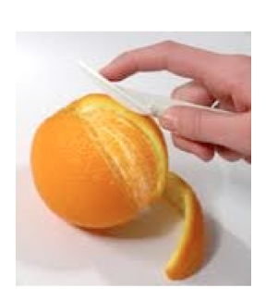
Atmosphere = a thin layer of air that forms a protective layer around the Earth.
But, protects Earth from what?

Slide 3
Protection from...
….too much heat from the sun during the day
....being too cold at night (keeps in heat)
....from the sun's harmful rays.

Slide 4
What gases are in the atmosphere?
Nitrogen - 78%
Oxygen - 21%
Other (Argon, Carbon Dioxide...) - 1%
Who can try to draw this on a pie chart?

Slide 5
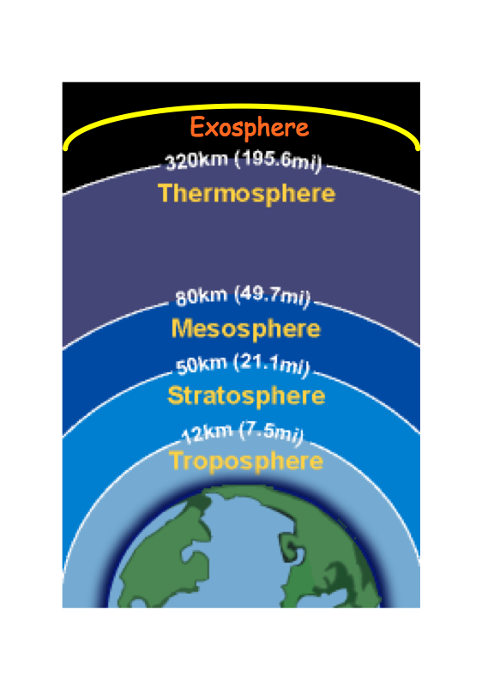
5 Layers of the Atmosphere

Slide 6
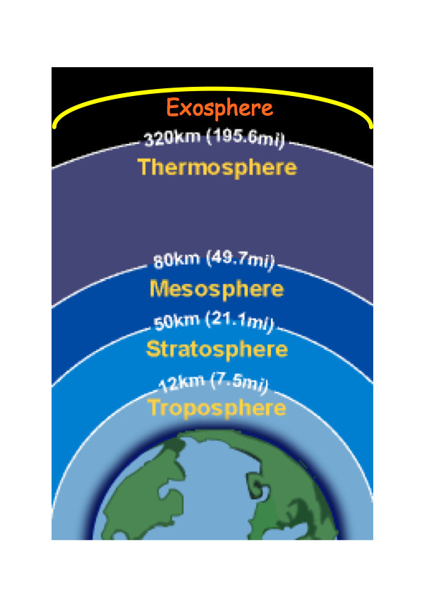
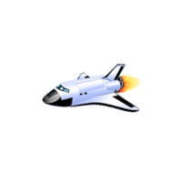
What happens in each layer?
Ozone

Slide 7
